Slide 1
Fake News
Detection
Jason, Joey, Grace,
Shan, Serena, Kimmy

Slide 2
Agenda
Problem Statement
Data Description
Methodology
Conclusion
Business Value

Slide 3

Problem statement
Detect Fake News and Fake News Spreader Community based on News Content & Users Network
Notes:
Understand the behavior of fake news spreader group as it is important to realize how some organization hire a group of spreader to manipulate or mislead opinion trend.

Slide 4
Data Description
News and social context information from PolitiFact
240 News
120 fake news, 120 real news
News id, content
23,865 Twitter Users
User-user relationship
News-user relationship
Notes:
- News.txt: the news_id list, index by the row num. For example, 'PolitiFact_Real_1' is in the 1st row, so it's corresponding to index 1.
- User.txt: the user_name list, index by the row num. For example, 'f4b46be21c2f553811cc8a73c4f0ff05' is in the 1st row, so so it's corresponding to index 1.
- FakeNewsContent/@news_id_Webpage.json: the detail fake news content meta data, with news source, headline, image, body_text, publish_data, etc. The file name is the news id.
- RealNewsContent/@news_id_Webpage.json: the detail real news content meta data, with news source, headline, image, body_text, publish_data, etc. The file name is the news id.
- PolitiFactNewsUser.txt: the news-user relationship. For example, '240 1 1' means news 240 is posted/spreaded by user 1 for 1 time.
- PolitiFactUserUser.txt: the user-user relationship. For example, '1589 1' means user 1589 is following user 1;
PolitiFact: a fact-checking website. Journalists and domain experts review the political news and provide fact-checking evaluation results to claim news articles as fake or real.

Slide 5
Methodology
2-Mode Networks
Transformed 1-Mode Networks
Clustering Coefficients
Clique and K_core
Logistic Regression & Random Forest

Slide 6
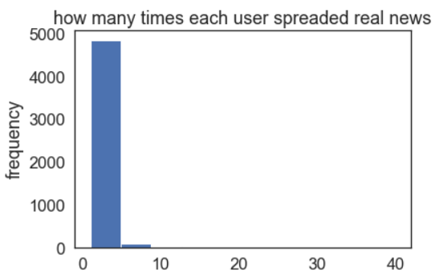
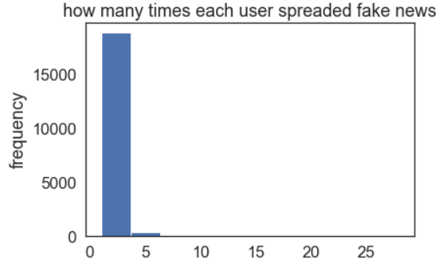
Real vs Fake

Slide 7
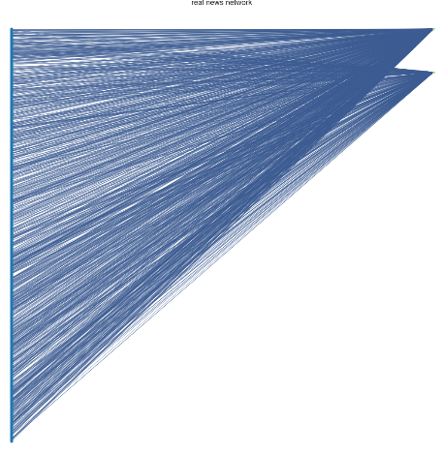
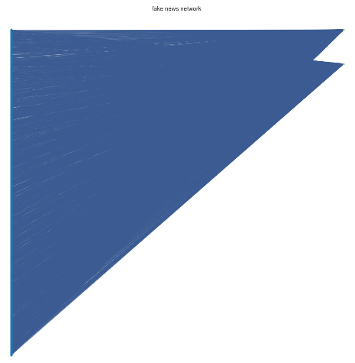
2-mode networks
Real News Network
Fake News Network

Slide 8
Clustering Coefficients
Global Clustering Coefficients (Robins and Alexander Clustering)
Fake news 2-mode network: 0.040
Real news 2-mode network: 0.197
Notes:
Global clustering coefficient: four times the number of four cycles, divided by the number of three paths in a bipartite graph.
Explanation: More squares are formed in the real news network than in the fake news network, because in the fake news network, only the fake news spreader will keep spreading the fake news. Common people will figure out some fake news and therefore lose connection to the fake news spreader.

Slide 9
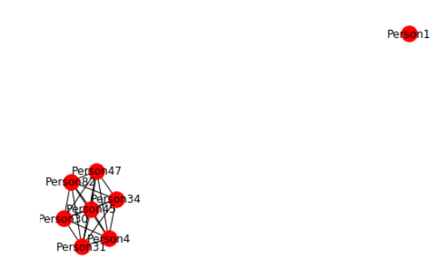
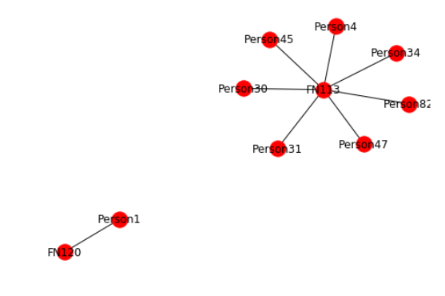
1-mode networks
Projection: The common method to transform 2-mode to 1-mode
Notes:
Projection: This method operates by selecting the primary nodes and linking two nodes if they have at least one common secondary node.

Slide 10
1-mode networks
Issues of Projection:
Tends to have more and larger fully-connected cliques than prototypical 1-mode networks.
The density and average degree of two transformed 1-mode networks are very close.
Notes:
Projection: This method operates by selecting the primary nodes and linking two nodes if they have at least one common secondary node.

Slide 11
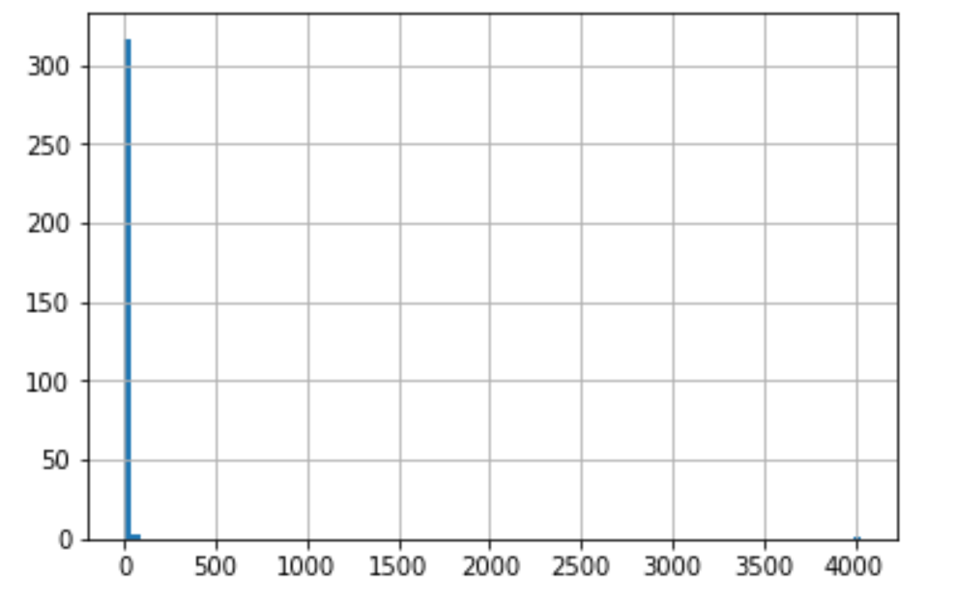
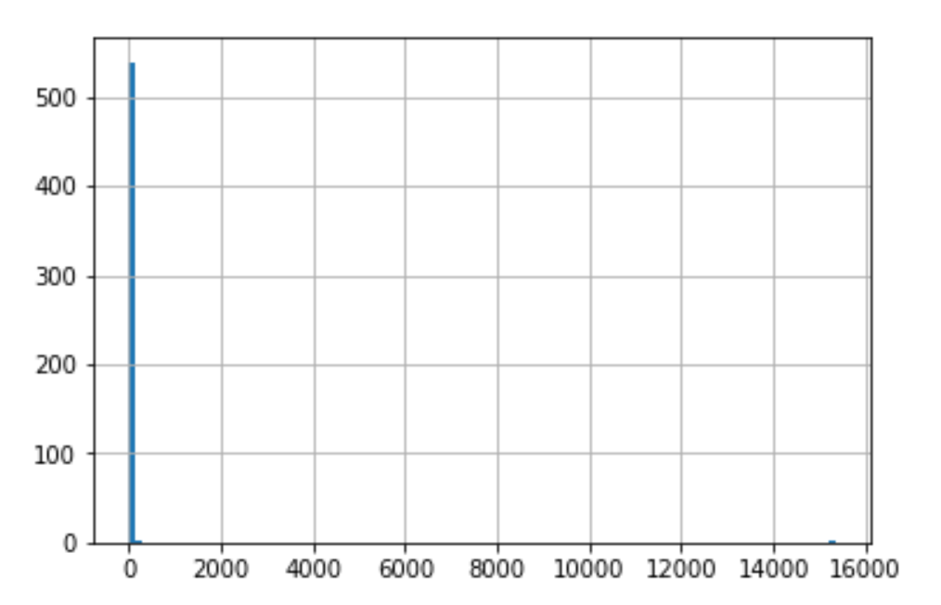
Clique
Real News
Fake News
Mean Clique: 186.82
Mean Clique: 389.42
Notes:
Cliques and k-cores are two methods to identify sub-groups of a social network relationship.

Slide 12
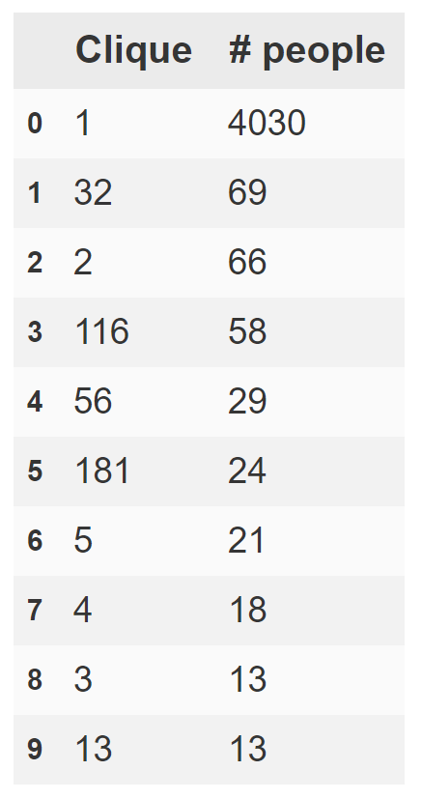
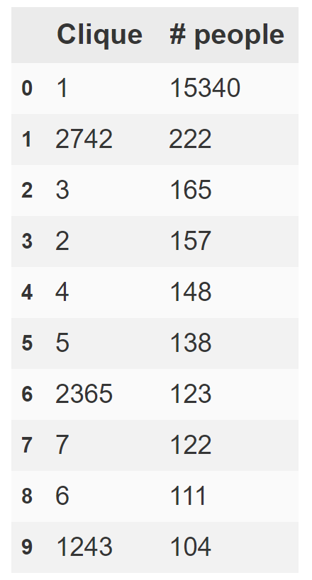
Fake News “Criminal Group”
Real News
Fake News

Slide 13
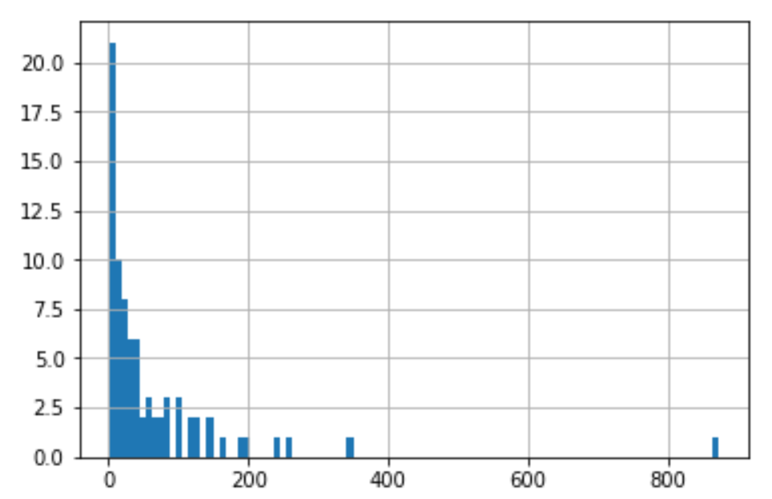
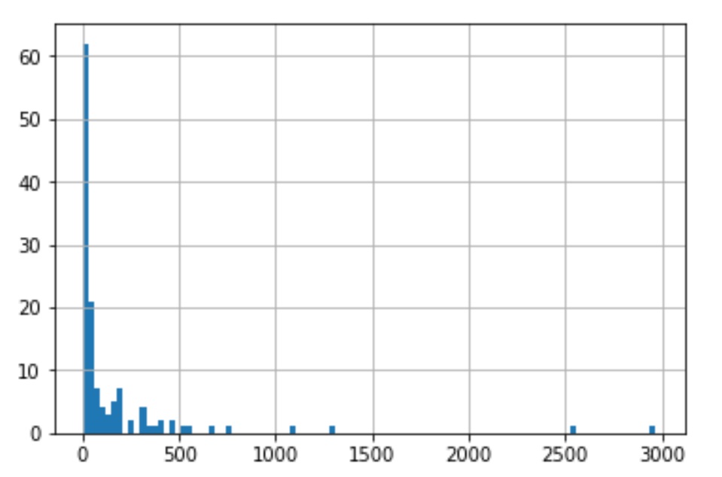
K-core
Real News
Fake News
Mean K-core: 284.46
Mean K-core: 1187.40
Notes:
To sum up our findings, clustering coef of the fake news network tends to be lower, because people have basic knowledge to differentiate the fake news and real news. So overall, people do not propagate the same fake news and the square would be less than real news. But for one mode settings, we see that clique and kcore of the fake news network tend to be higher. The reason is that people who propagate fake news work together as a group

Slide 14
Fake News Detection
Random Forest: Use news’ content and network characteristics to predict whether it is a real news or fake news
Variables | Accuracy (MSE)
News’ content only | 0.185
Network characteristics only | 0.385
Both | 0.168
Notes:
Tried logistics regression: using the network characteristic didn’t influence the confusion matrix, and therefore used the random forest to check the results.

Slide 15
Drawback
Number of both types of news are not enough
Closeness and betweenness are not available for such large network
Notes:
There are only 240 news in total, not enough data to train the model, which is also the reason why the confusion matrix didn’t change: the test size is too small.
Recently, most of the articles about using network characteristic to analyze real life network just use degree. The potential reason is that there are still not advanced algorithm to get the betweenness and closeness for large network.

Slide 16
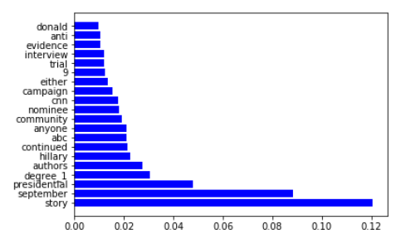
Feature importances
Notes:
Degree ranks num 4 in the feature importances plot.
We can also get an overview of fake news detection: Presidential, hillary, ABC, CNN, Donald

Slide 17
Conclusion
Social Network Characteristic can help detect fake news spreader group within social network
Social Network Characteristic can improve the accuracy of detecting fake news

Slide 18
Business Value & Potential Application
Fake News Detection
Fake News Evolution
track the life cycle of fake news on social media
Fake News Mitigation
reduce the negative effects brought by fake news
Malicious Account Detection
identify social bots, trolls, and cyborg users

Slide 19
Thank you!
Questions?

